Slide 1
Preserving Our Planet for the Grandchildren and All Life

Slide 2
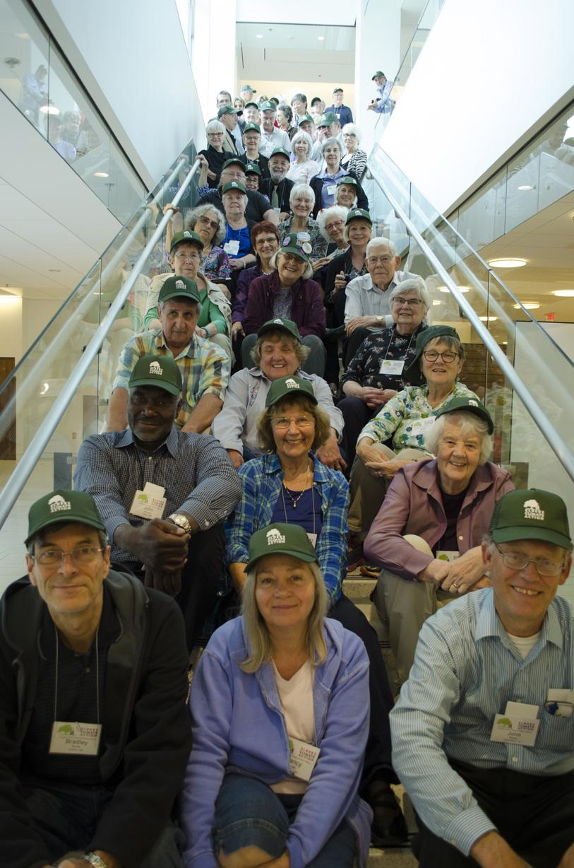
Who We Are
Elders Climate Action mobilizes elders throughout the United States to address climate change while there is still time to protect the wellbeing of our grandchildren,
future generations and all life.

Slide 3
Our Mission
We are dedicated to using the power of our caring, our wisdom and our numbers to push for strong energy policies that will reduce greenhouse gases in our atmosphere to a level consistent with life thriving on our planet.

Slide 4
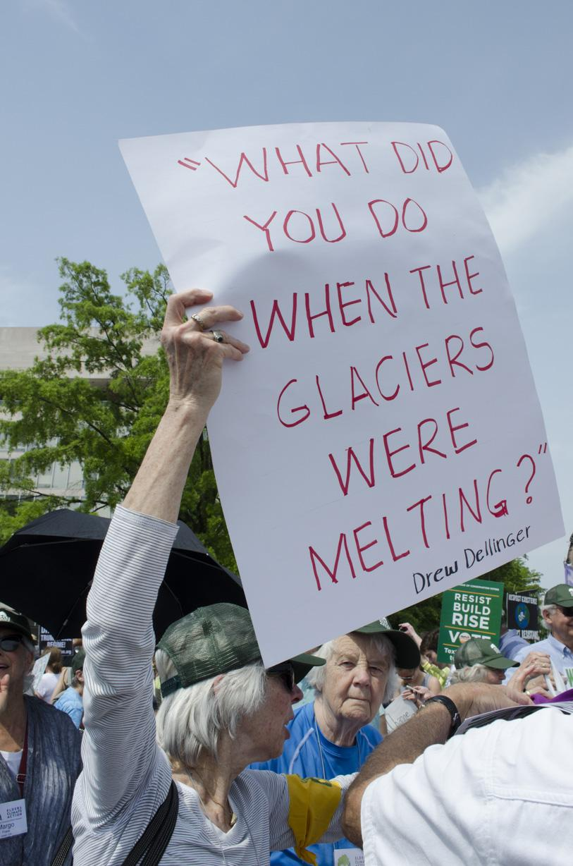
A Closer Look
We are a young organization – launched in 2014
A campaign of Conscious Elders Network, a not for profit and non partisan organization
All Elder volunteers
3500 members, represented in all 50 states
Four local ECA Climate Action Teams organized as chapters with more to come
We currently have 62 partner organizations

Slide 5
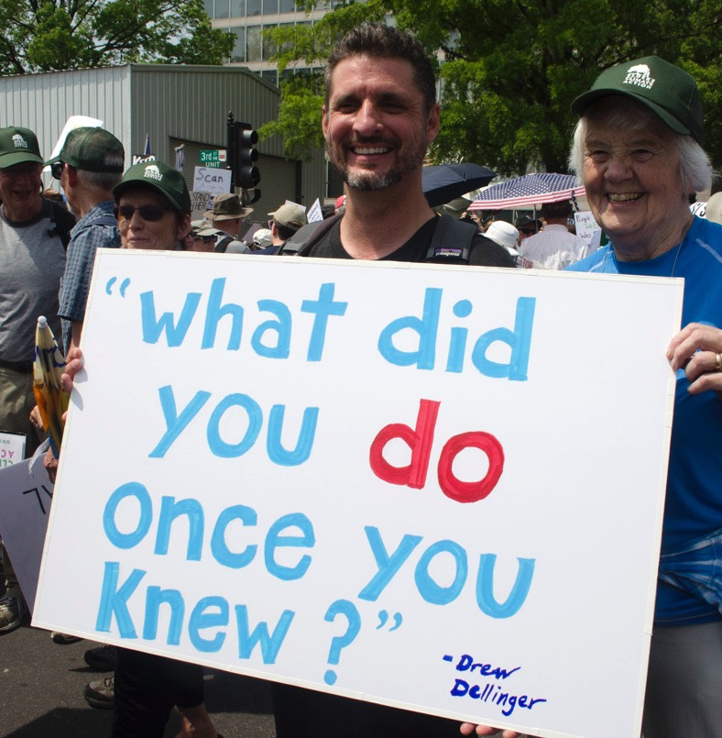
Did You Know?
Baby Boomers are the largest voting bloc in the United States. Making up 32% of registered voters, an estimated
80 million elders!

Slide 6
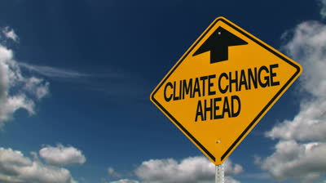
Our Core Initiatives
Carbon Fee and Dividend legislation
EPA emissions regulations
State and local policies
Fossil fuel divestment

Slide 7
We advocate for policies that will:
Discourage and eventually halt any further extraction of fossil fuels from the Earth.
Reduce present emissions from the burning of fossil fuels.
Seek and encourage means to draw down carbon from the atmosphere into carbon sinks.
Promote forms of clean energy, including new and emerging technologies.
Build relationships and collaborations with like-minded groups to promote our goals.

Slide 8
ECA Current Priorities
Support of Revenue Neutral Carbon Fee and Dividend Legislation.
Support of effective cap and trade policies.
Encouragement of our elected representatives in Congress to join the bipartisan Climate Solutions Caucus.
Full implementation of the Clean Power Plan (CPP).
Support of Obama-era regulations to significantly reduce methane emissions.
Reduction of US carbon emissions that exceed the goals set in the
Paris COP 21 climate agreement. While the current Administration
has rejected the Paris accords, we actively support local community,
city and state actions aimed at achieving the COP 21 goals.
Support of all forms of carbon sequestration through natural
biologic processes.

Slide 9
ECA supports the following actions by our members, chapters and partners:
Divestment of fossil fuel stocks from portfolios held by private institutions and pension funds.
Opposition to further extraction of fossil fuels from the ground by adopting policies to:
Ban offshore drilling for fossil fuels.
Phase out hydraulic fracturing as a method of mining fossil fuels.
End government subsidies of fossil fuels.
Oppose the use in fossil fuel cases of the investor-state dispute settlement (ISDS), which has been increasingly used by corporations to bully governments to protect their profit rates.
Oppose construction of additional pipelines carrying fossil fuels through the U.S.
Remove special interest money from US political campaigns as it pertains to fossil fuels.
Support of environmental justice for low-income and minority communities who may suffer more from the impacts of pollution of their air, ground and water as a result of extracting and/or burning fossil fuels.
Support of certain lawsuits such as Our Children’s Trust, a lawsuit against the federal government for violating the younger generations' constitutional rights through its ill-advised actions in causing climate change.

Slide 10
Building a movement at local, state and national levels
A non-partisan community of engaged elders
Developing partnerships with a broad spectrum of other organizations
Have fun and develop new connections as we work together
We have many volunteer opportunities waiting for you
Together We Will Make Our Voices Heard!

Slide 11
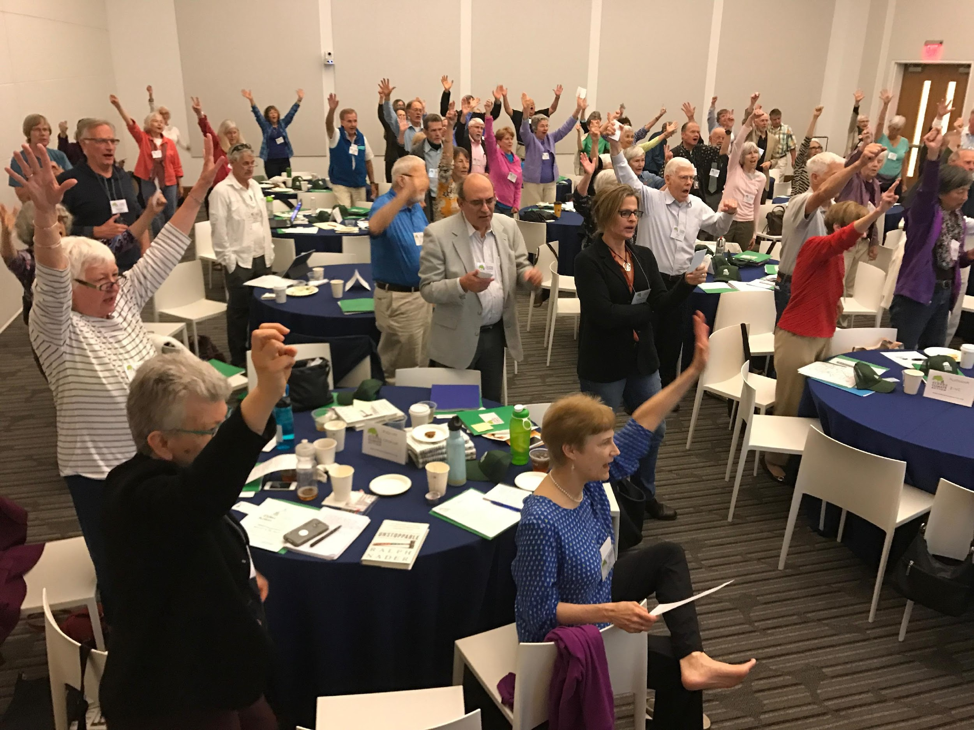
The Voices Of Elders Matter!

Slide 12
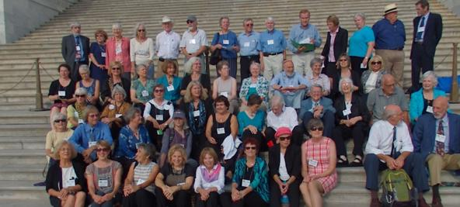
Coming Together As Elders
Grandparents Climate Action Day 2015
A gathering of elders in Washington for a day of inspiration and education, and a day of meetings with 44 Members of Congress
The first ever ECA Flash Mob with Elders in Union Station and a Congressional Dining Room ECA Flash Mob

Slide 13
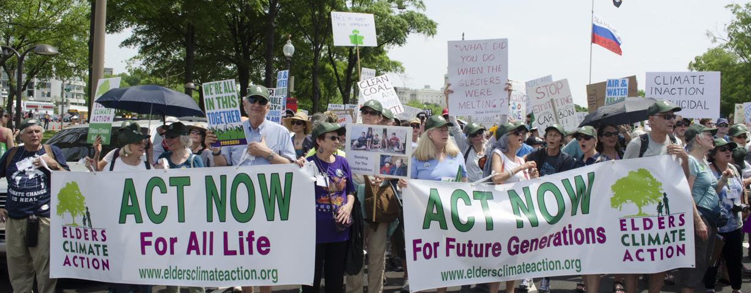
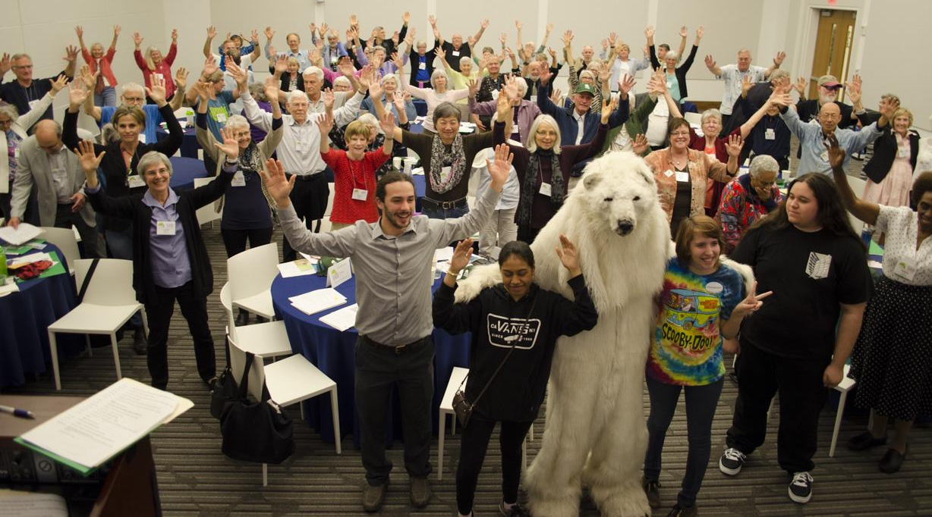
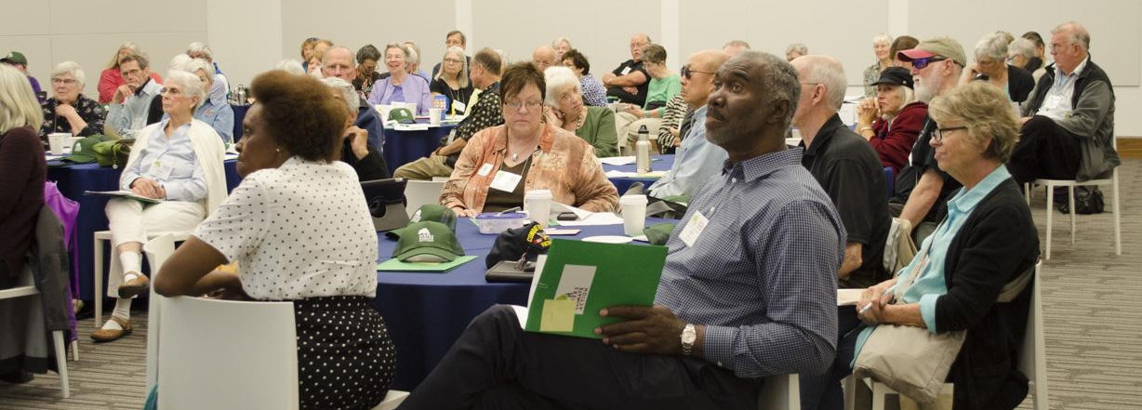
Elders Climate Action Day 2017
Elders joined together in Washington D.C. for a day of education and inspiration, a day of lobbying, and a day of marching!
We delivered our Climate Pledge to all 535 members of Congress. Watch Slideshow Now
We marched with an estimated 250,000 people in the People’s Climate March.

Slide 14
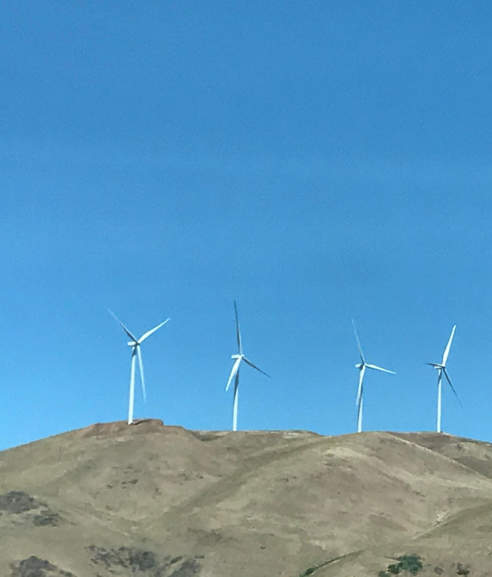
ECA Takes Action
Congressional Candidates Climate Project 2016
Elders Climate Voter Pledge 2016
Stop Pruitt’s Nomination to the EPA Campaign
Monthly Newsletter
Monthly National and Volunteer Calls

Slide 15
How We Elders Engage
Chapters
An organized group in a specific geographic area
Collaborations
Specific initiatives with another organization
Teams
Small group identifies a project
National Committees
Participate in an ECA leadership committee

Slide 16
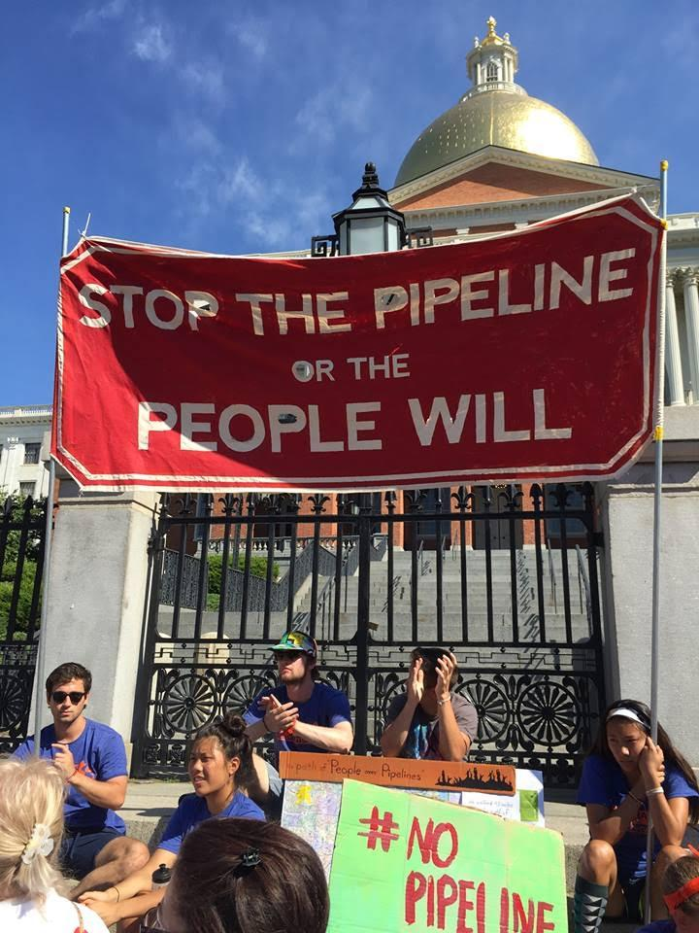
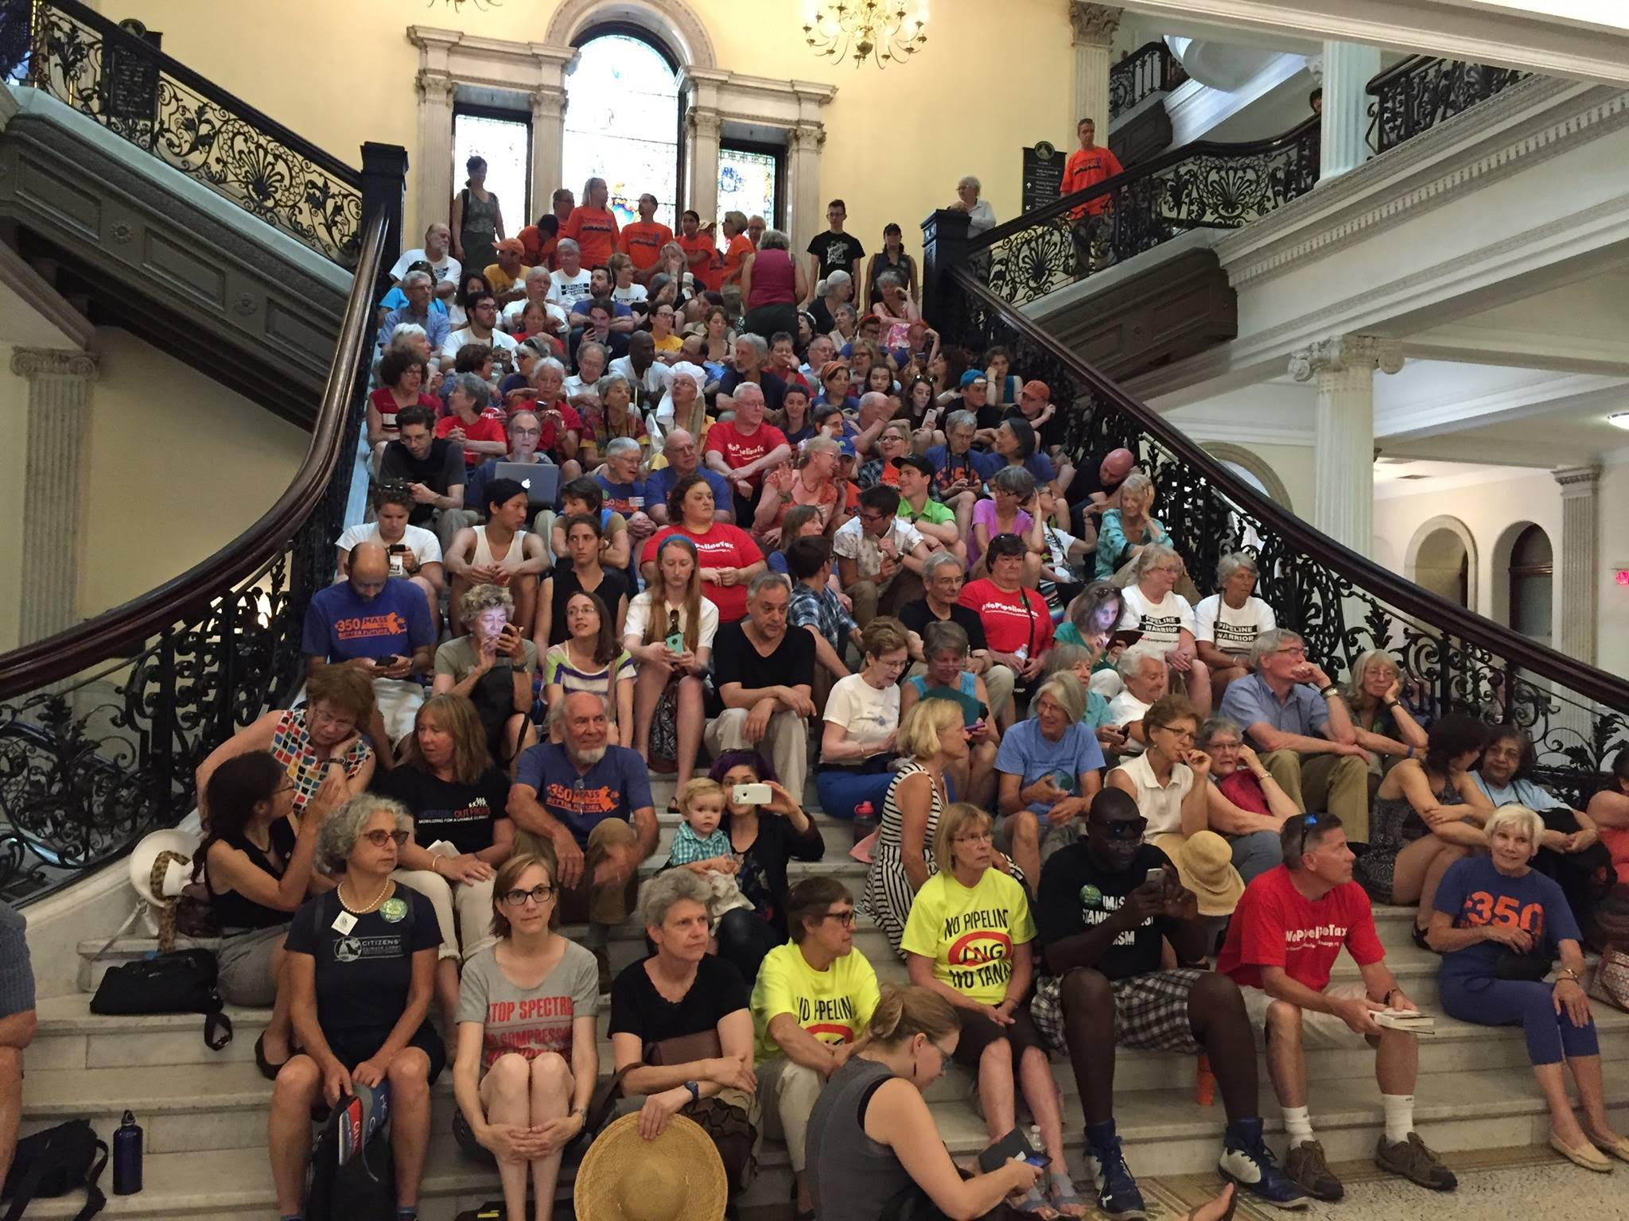
ECA Local Chapters
Massachusetts Chapter
A Local Climate Action Team
Formed in early 2016 with statewide membership
Alliances with other environmental groups
State legislation on an energy bill
Presentations to groups of elders
Communications with members
Participates in local efforts
massinfo@eldersclimateaction.org
Ann Arbor, MI Chapter
The Ann Arbor Area chapter was approved early in 2017. We mix both activist and educational activities with opportunities to socialize in order to build a strong community. Our primary focus is local issues, working in conjunction with partner climate organizations to avoid reinventing the wheel.
annarbor@eldersclimateaction.org

Slide 17
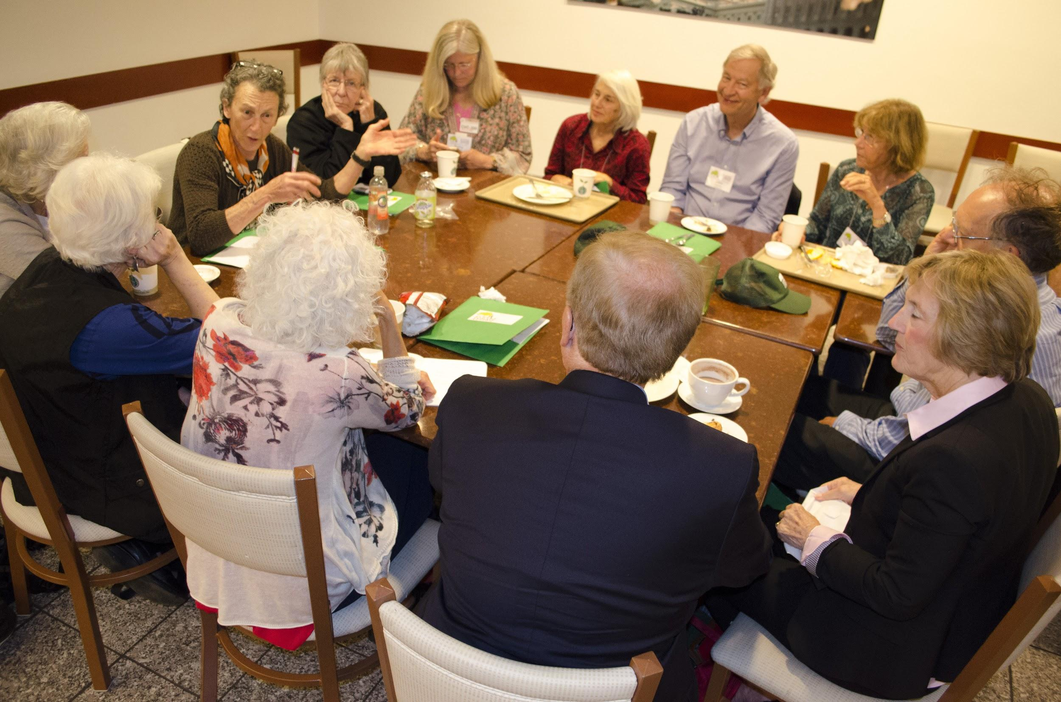
New Local Chapters
Northern California
(NorCal Chapter)
Inspired by ECAD 2017
Newly formed in the summer of 2017.
Covers large geographic area including the Bay Area, rural Northern California and Central valley communities.
Interested in local action, statewide and regional policy, outreach to senior communities and collaborating with partners
norcal@eldersclimateaction.org
Maryland Chapter
Since May, a group of elders have met five times, have submitted an application to become an ECA chapter, are working to oppose the construction of a natural gas pipeline across the Potomac River, and are exploring ways to work with ECA partners on a variety of local, state and national initiatives to address climate change.
maryland@eldersclimateaction.org
Start a Chapter
in Your Area!

Slide 18
Leave a Legacy of Change
United we have the power to
Change energy policies
Reduce greenhouse gases
Create a planet where life continues to thrive

Slide 19
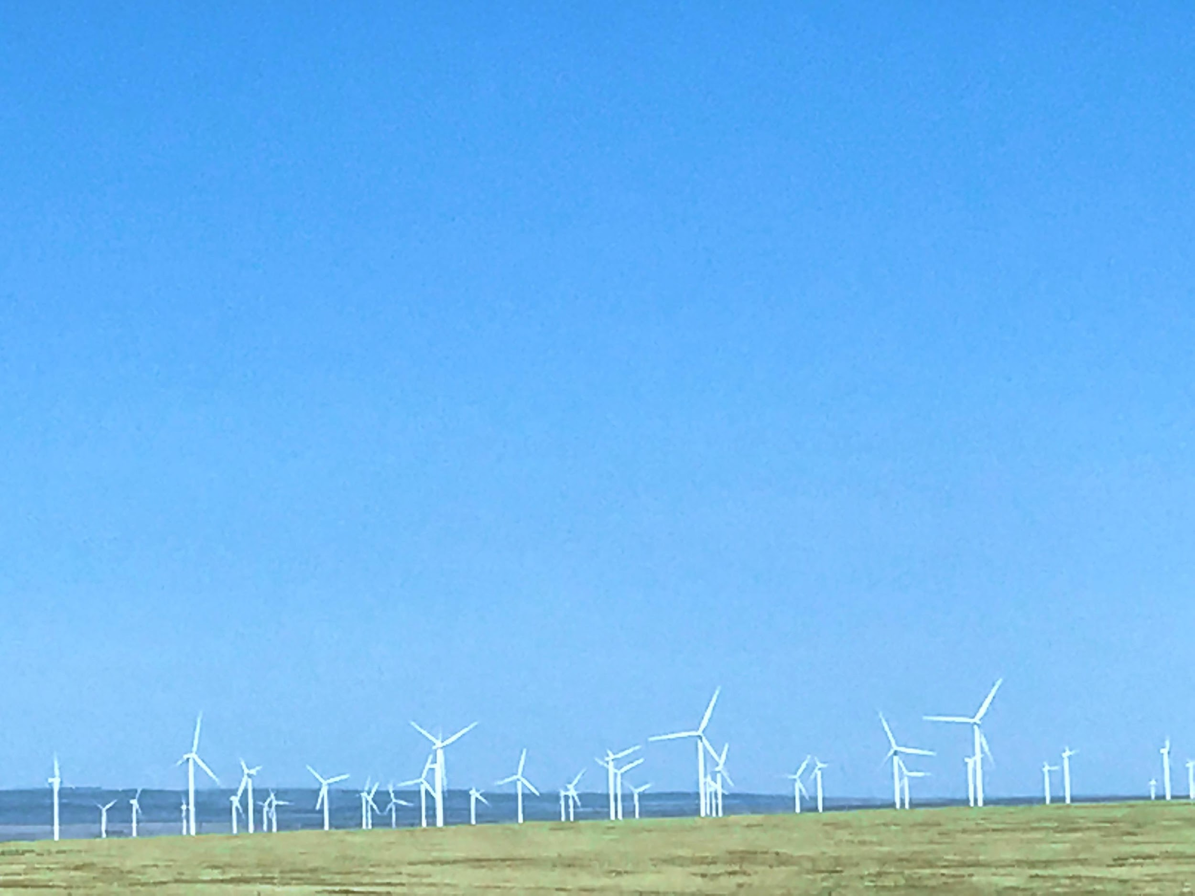
Take Action Now
for your grandchildren, future generations and all life.
10 Simple Ways to Participate
1. Organize a 2-3 member ECA team in your Congressional district or local community and schedule meetings with your Representatives
2. Send a letter to your Representatives. Visit our Website to send a letter today!
3. Join or Start a Local Chapter in your Area
4. Represent Elders Climate Action at Local/National Events
5. Like, Follow, Post and Share ECA on Facebook & Twitter

Slide 20
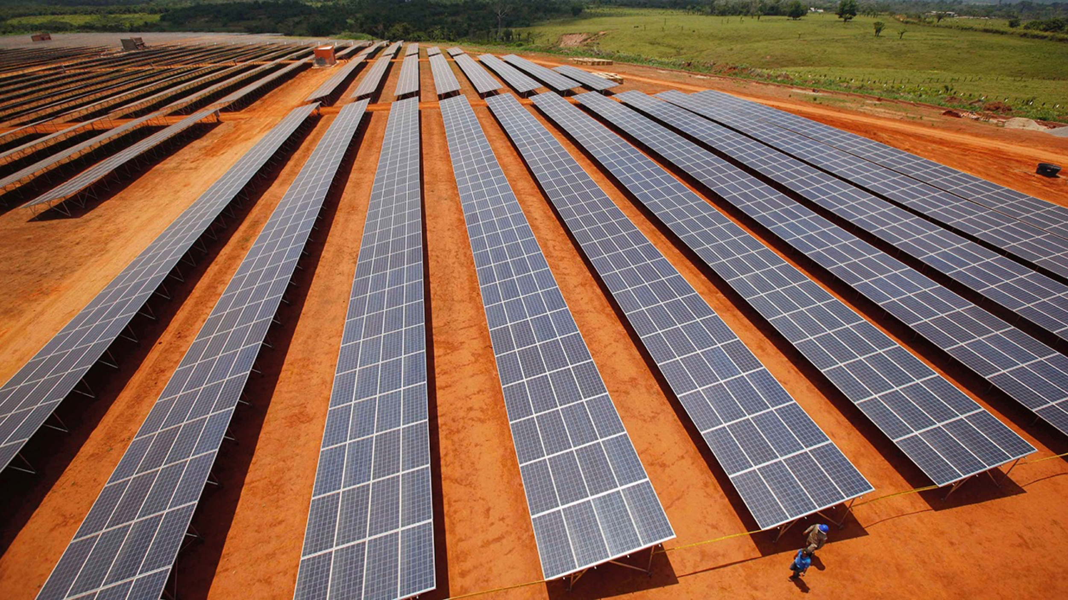
6. Learn more about joining an ECA Leadership Team
7. Contribute a Skill - write grant proposals, graphic design, produce newsletters, research, writing, administration, political advocacy, video production
8. Support ECA, Give a Gift Today. Make a tax-deductible contribution. Help keep our great work going!
9. Join our National Call! Get informed, inspired & engaged on our monthly call and hear what fellow climate advocates from across the country are doing.
10. Tell Your Friends and Family, and Help Us GROW!
For more info visit www.eldersclimateaction.org
or email us at info@eldersclimateaction.org
Help Us Build Brighter Future!

Slide 21
Find Us & Engage on Social Media!
Facebook: @eldersclimateaction
Twitter: @eldersclimate
YouTube: Elders Climate Action
www.eldersclimateaction.org

Slide 22
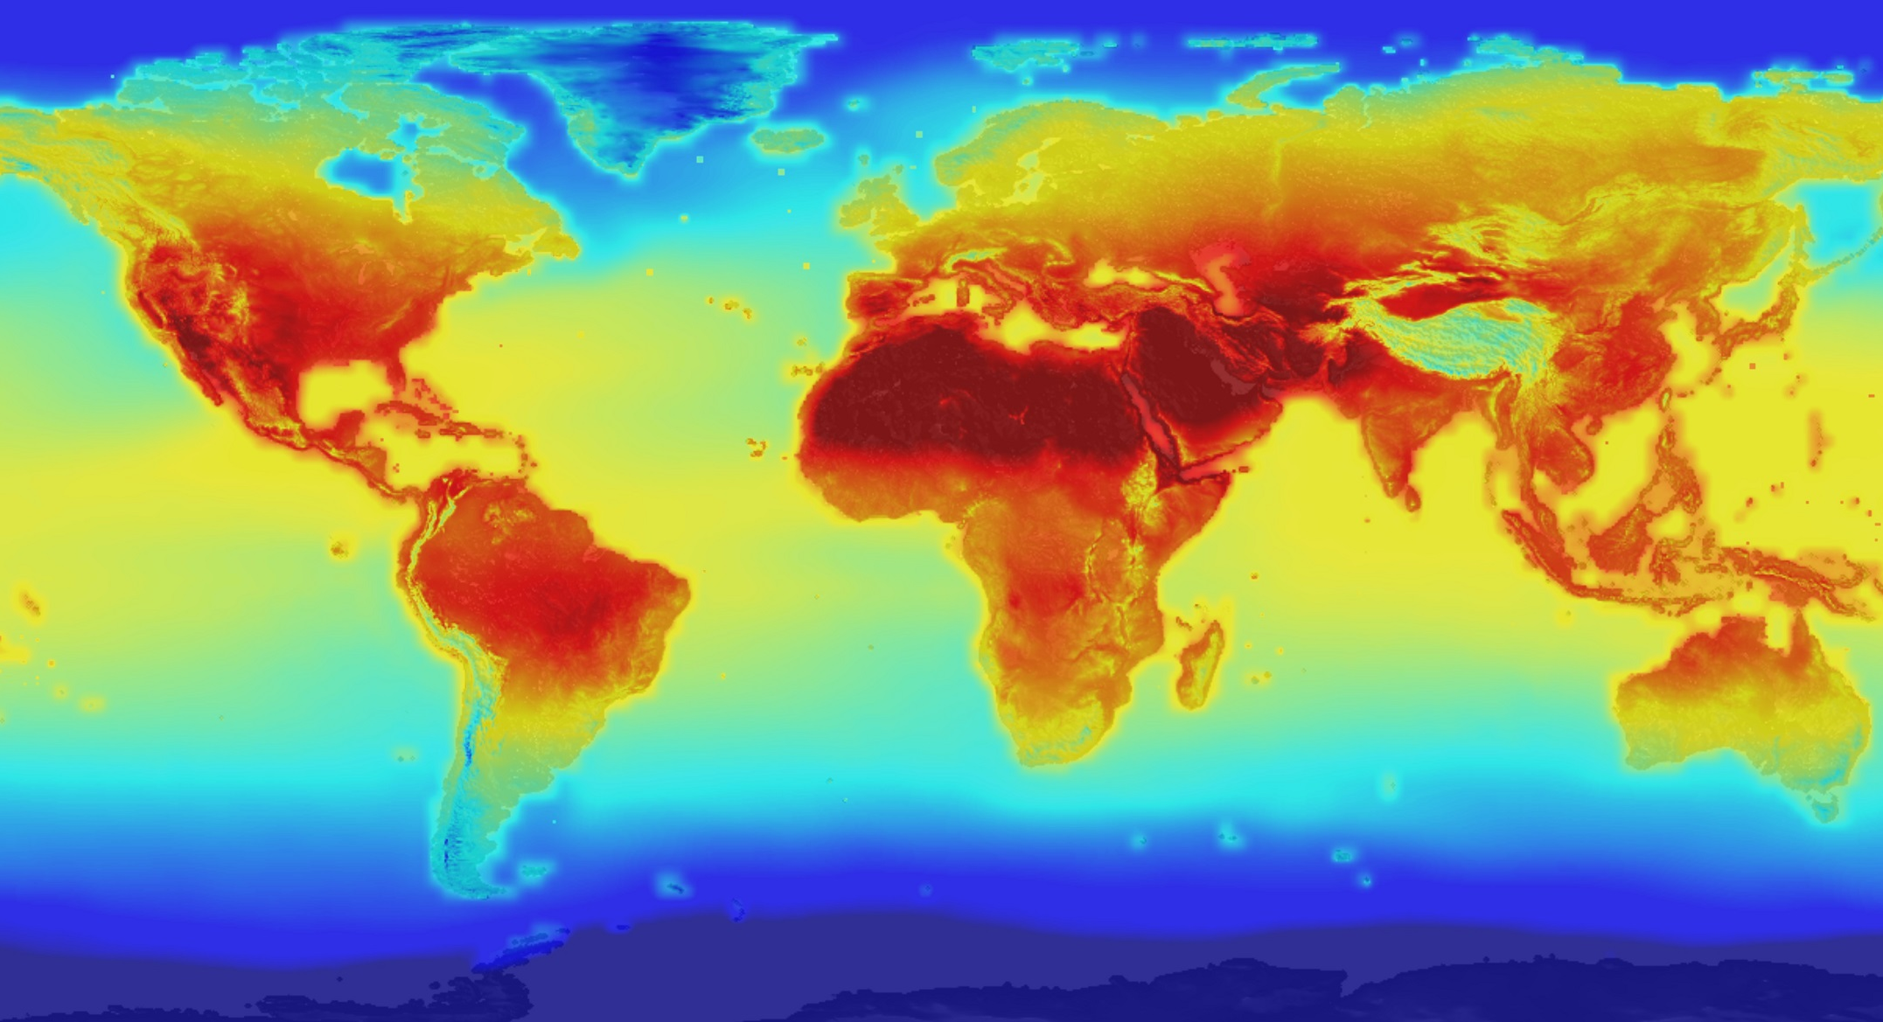
What Did You Do Once You Knew?

Slide 23
Thank You!
Together We Can Take Action on Climate Change!

Slide 24
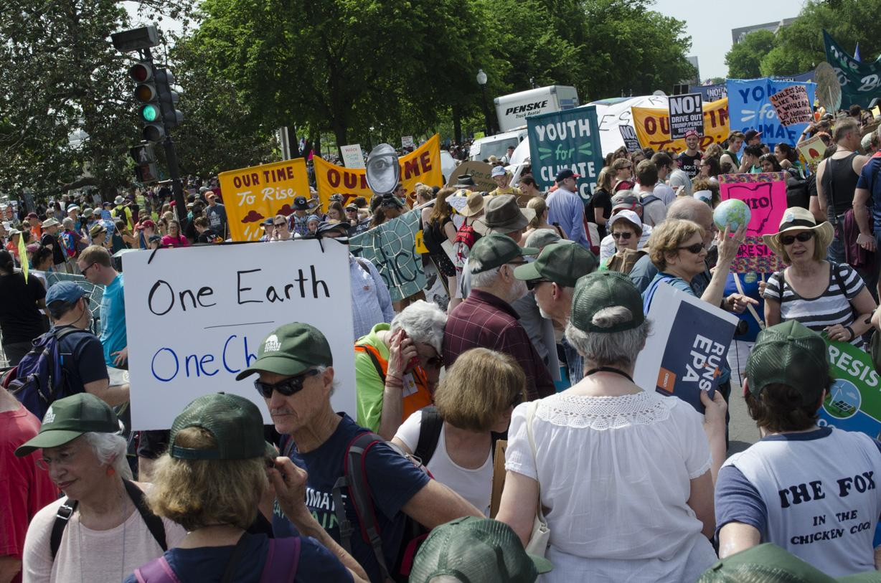
ECA In Action: Slideshow from the People’s Climate March

